Slide 1
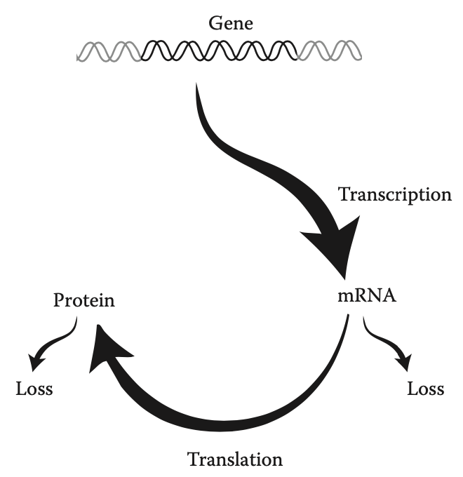
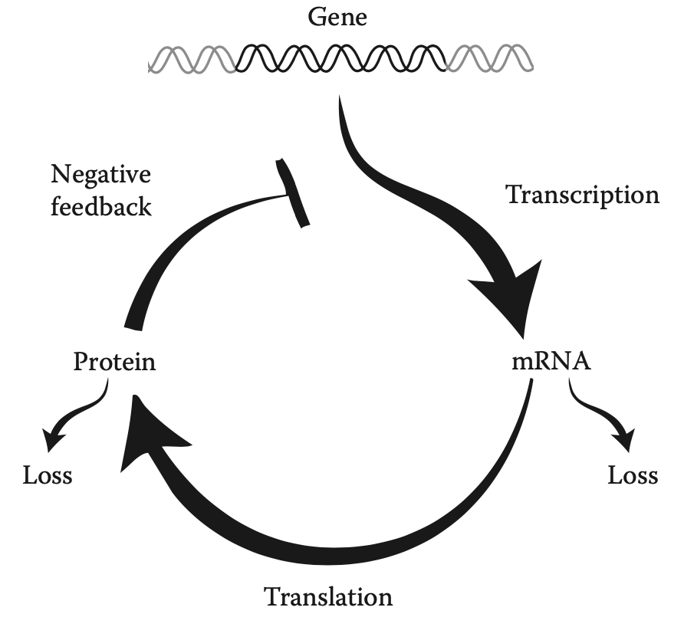
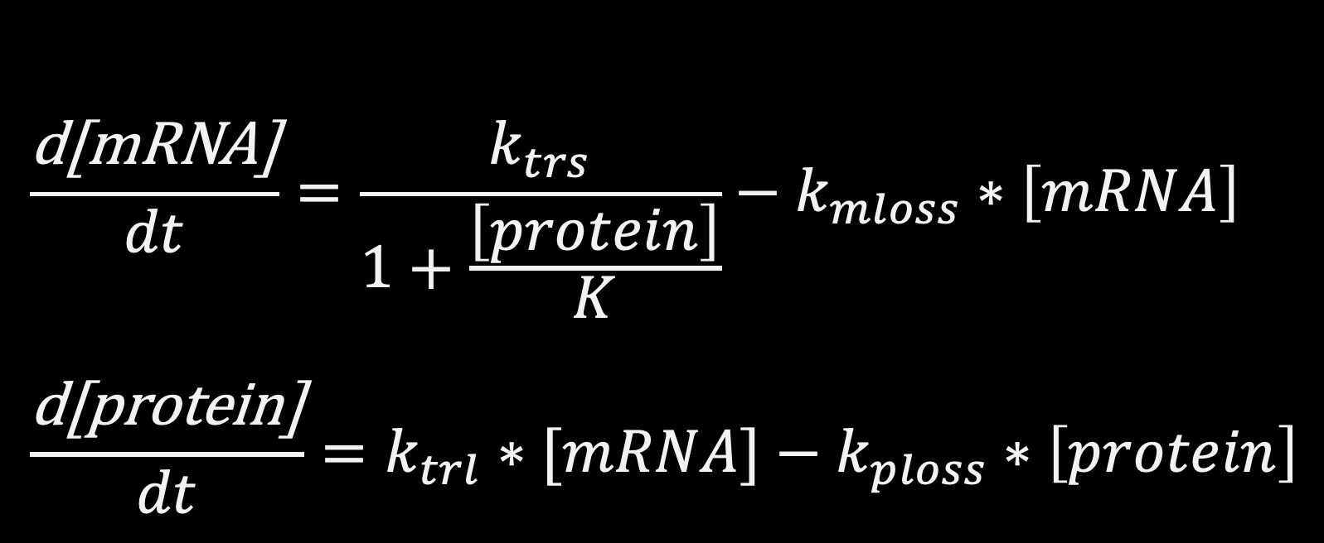
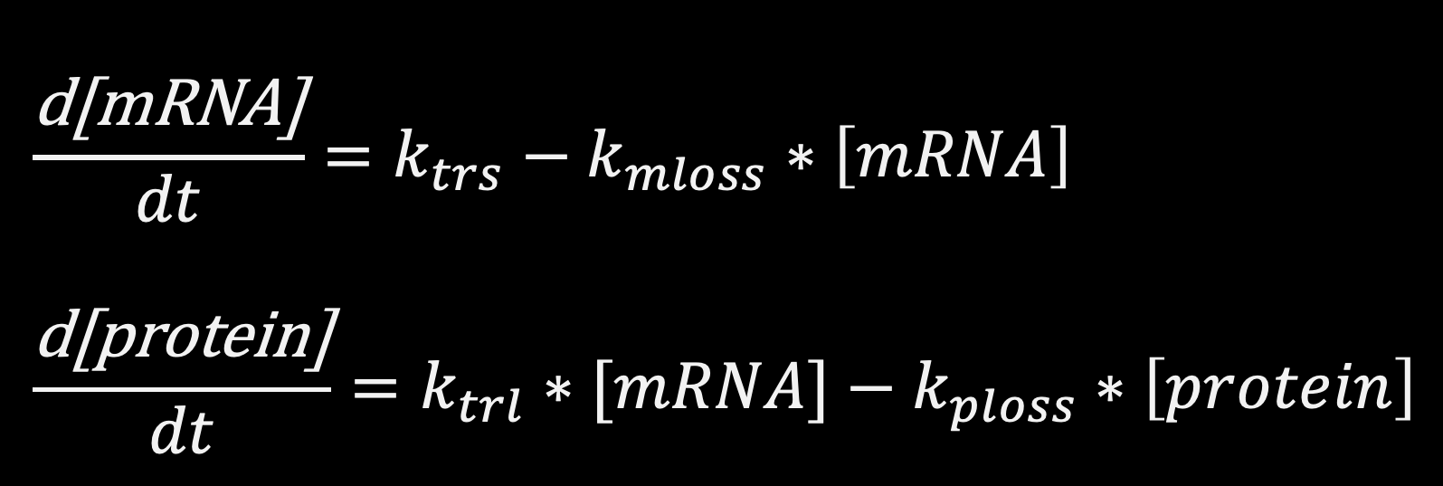
Transcription and translation
$$\frac{\text{d}\text{[}\text{mRNA}\text{]}}{dt}=\frac{k_{trs}}{1+\frac{\left[protein\right]}{K}}−k_{mloss}∗\left[mRNA\right]$$
$$\frac{\text{d}\text{[}\text{protein}\text{]}}{dt}=k_{trl}∗[mRNA]−k_{ploss}∗\left[protein\right]$$
$$\frac{\text{d}\text{[}\text{mRNA}\text{]}}{dt}=k_{trs}−k_{mloss}∗\left[mRNA\right]$$
$$\frac{\text{d}\text{[}\text{protein}\text{]}}{dt}=k_{trl}∗[mRNA]−k_{ploss}∗\left[protein\right]$$
Notes:
Fundamentals of Systems Biology, by MW Covert: Chapters 3 and 4
Rosenfeld, N., Elowitz, M.B., and Alon, U. Journal of Molecular Biology 2002, 323(5): 785–793

Slide 2
ODE Models: Michaelis-Menten and Mass Action Kinetics
An Introduction to biochemical regulation kinetics

Slide 3

Modeling Approaches
(non exhaustive list)
undefined state
continuous state
State
Time
discrete or continuous
(not shown)
discrete state
distribution
of states
Statistical inference
Agent-based
Petri nets
Fuzzy logic
ODE
PDE
Biophysical
Gene ontology
Cellular automata
Boolean
Markov chain
Stochastic rule-based
Molecular
Abstraction
Detail/complexity
Dynamical
Each has specific technical foibles and a vast associated technical literature, but each has the same logical structure
ƒ(inputs) = output

Slide 4
Introduction to ODEs
Graphical Analysis of ODEs
Michaelis-Menten and Mass Action Kinetics
Regulations in biology have signs (positive vs negative), but also have strength which could change over time or as a function of the concentration of the regulator.
Mass action kinetics
Michaelis-Menten kinetics
Cooperativity
Hill functions
Multi input functions
Modeling biological systems with ODEs

Slide 5


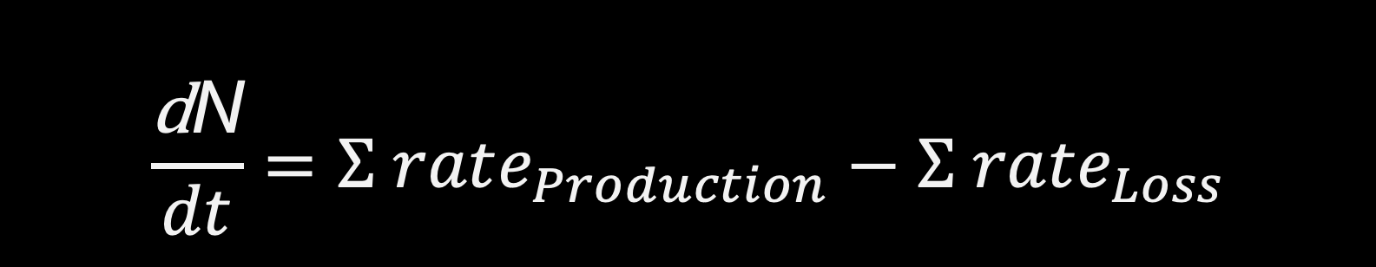
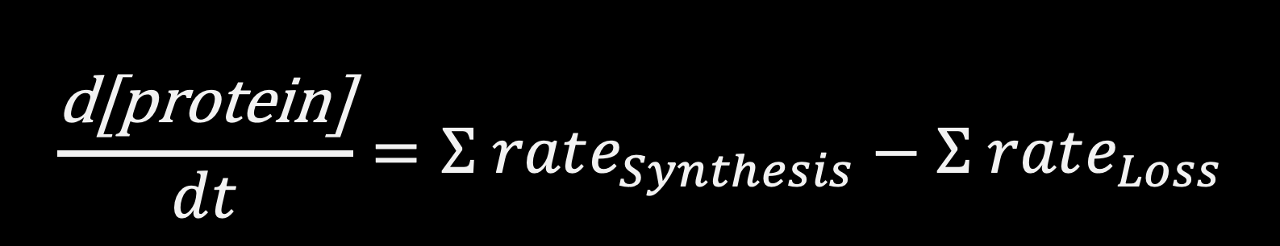
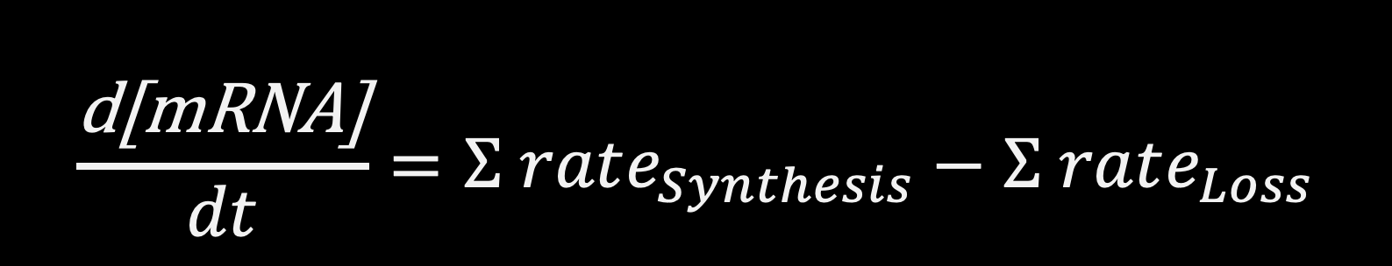
Conservation of mass
A population of cells
mRNA counts
Division
Migration in
Cell death, apoptosis
Migration out
transcription
Degradation, RNase
Dilution
$$\frac{\text{d}\text{N}}{dt}=Σ rate_{Production}−Σ rate_{Loss}$$
$$\frac{\text{d}\text{[}\text{mRNA}\text{]}}{dt}=Σ rate_{Synthesis}−Σ rate_{Loss}$$
protein copies
protein activity
kinases
phosphatases
Negative feedbacks
translation
Degradation, Protease
Dilution
$$\frac{\text{d}\text{[}\text{protein}\text{]}}{dt}=Σ rate_{Synthesis}−Σ rate_{Loss}$$
$$\frac{\text{d}\text{[}\text{protein}\text{−}\text{p}\text{]}}{dt}=Σ rate_{Phosph}−Σ rate_{dephos}$$
Notes:
Proteases are enzymes that degrade proteins by breaking the peptide bonds of proteins.
RNases (or ribonucleases) are a class of hydrolytic enzymes that catalyzes both the in vivo and in vitro degradation of ribonucleic acid (RNA) molecules into smaller components. The nuclease operates at the level of transcription and translation and breaks down the RNA by cleaving the phosphorus-oxygen bonds.

Slide 6



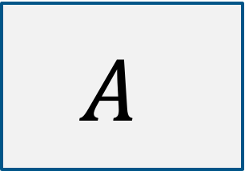
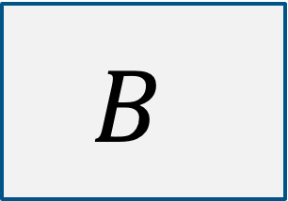
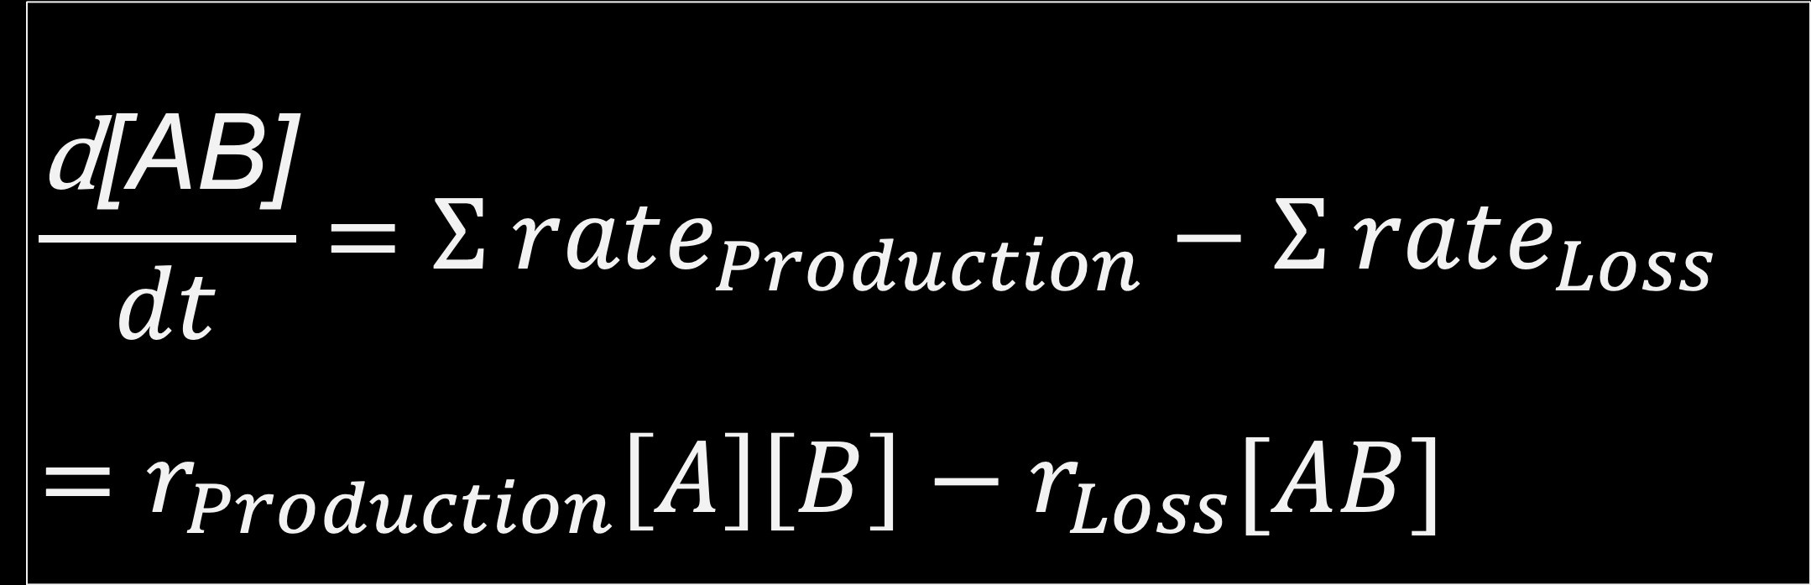

Mass Action law
$$r_{Production}$$
$$A$$
$$+$$
$$B$$
$$AB$$
$$r_{Loss}$$
$$\frac{\text{d}\text{[}\text{AB}\text{]}}{dt}=Σ rate_{Production}−Σ rate_{Loss}$$
$$=r_{Production}\left[A\right]\left[B\right]−r_{Loss}[AB]$$

Slide 7
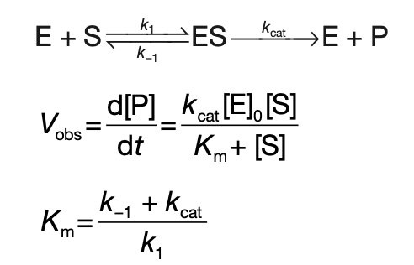
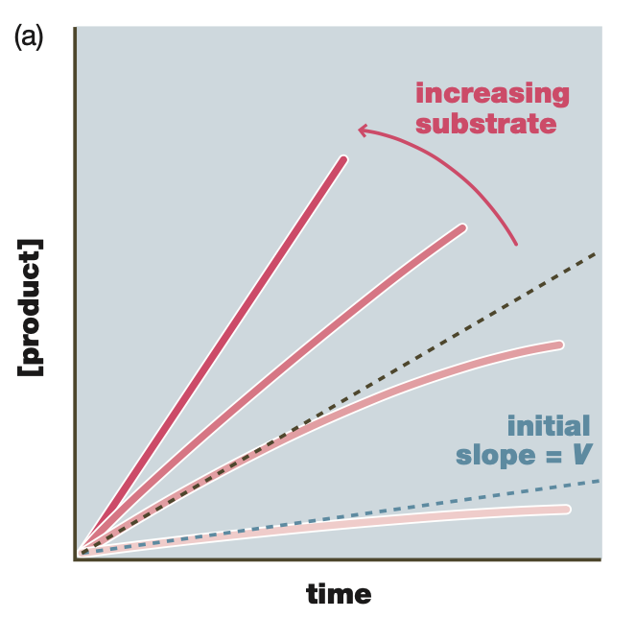
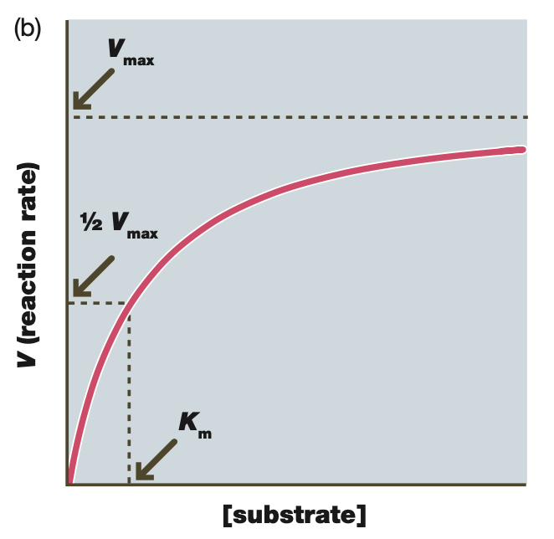
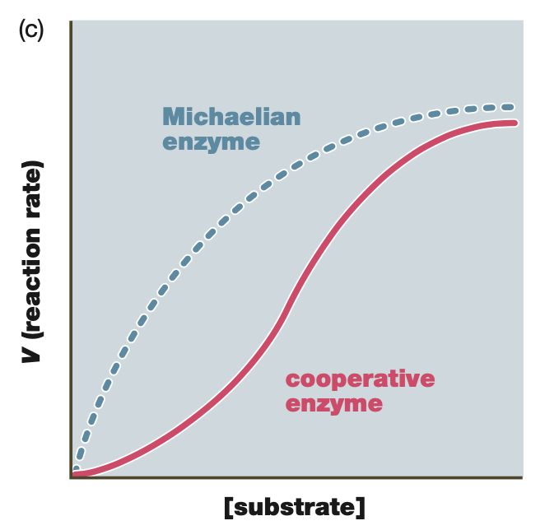
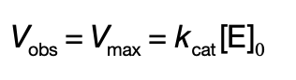
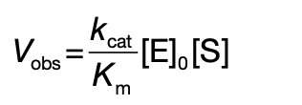


Michaelis-Menten Kinetics
Michaelis–Menten analysis provides a way to measure the catalytic power of enzymes. Many of the key proteins involved in signal transduction, gene regulation, and metabolism are enzymes, such as kinases and phosphatases, and their function in signaling often revolves around regulated changes in their activity. It is named after German biochemist Leonor Michaelis and Canadian physician Maud Menten.
E: Enzyme
S: Substrate
ES: Enzyme-Substrate complex
P: Product (Regulated Substrate)
k₁: forward rate constant
k₂: reverse rate constant
k_{cat}: catalytic rate constant
k_{cat}: maximum rate achievable for saturating substrate concentration
K_{m}: substrate concentration of half-maximal velocity
A measure of affinity of
enzyme for its substrate
Limit: $\left[S\right]≫K_{m}$
Limit: $\left[S\right]≪K_{m}$
Notes:
The Michaelis–Menten constant (Km) is a measure of the affinity of the enzyme for its substrate. The Km is the substrate concentration at which half-maximal reaction velocity is achieved; if the Km is relatively low, the reaction will proceed efficiently, even at relatively low concentrations of substrate
https://limlab.ucsf.edu/cellsignaling.html

Slide 8
Michaelis-Menten Kinetics
Michaelian Enzymes: One substrate protein binds to one enzyme.
Cooperative Enzymes: More than one substrate protein binds to an enzyme (often oligomeric enzymes), where binding of substrate to one subunit affects binding to the other subunits.
High cooperative enzymes result in:
switch-like output
threshold in substrate concentration
specific substrate concentration range for activity

Slide 9
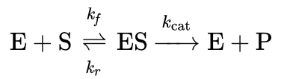
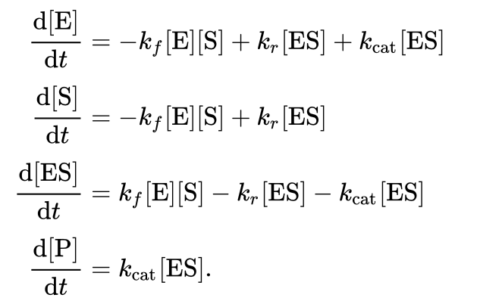
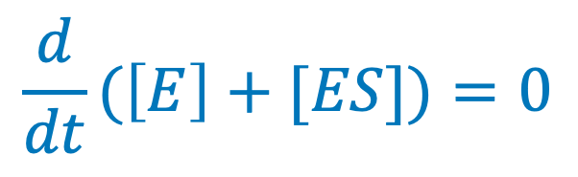
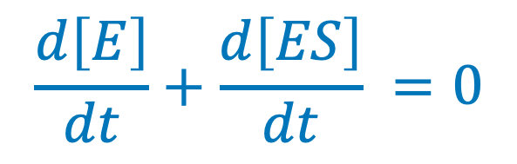
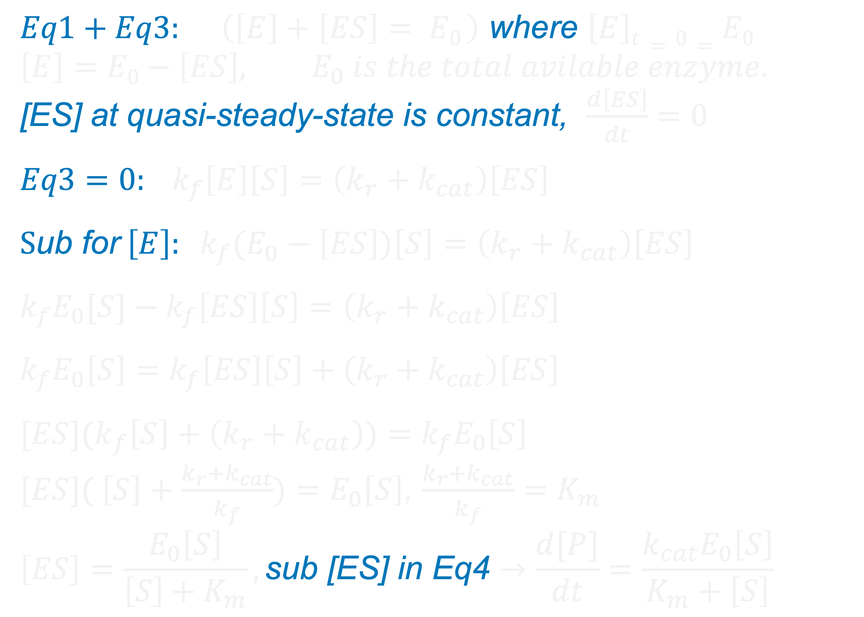
Michaelis-Menten Kinetics
$$\frac{d\left[E\right]}{dt}+\frac{d\left[ES\right]}{dt} =0$$
$$\frac{d}{dt}(\left[E\right]+[ES])=0$$
$$Eq1+Eq3: \left(\left[E\right]+\left[ES\right]= E0 \right) \text{where} \left[E\right]t=0=E0$$
$$\left[E\right]=E0−\left[ES\right], E_{0} is the total avilable enzyme.$$
[ES] at quasi-steady-state is constant, $\frac{d\left[ES\right]}{dt}=0$
$$Eq3=0: k_{f}\left[E\right]\left[S\right]=\left(k_{r}+k_{cat}\right)\left[ES\right]$$
$$S\text{u}\text{b} \text{for} \left[E\right]: k_{f}(E_{0}−\left[ES\right])\left[S\right]=\left(k_{r}+k_{cat}\right)\left[ES\right]$$
$$k_{f}E_{0}[S]−k_{f}\left[ES\right]\left[S\right]=\left(k_{r}+k_{cat}\right)\left[ES\right]$$
$$k_{f}E_{0}\left[S\right]=k_{f}\left[ES\right]\left[S\right]+\left(k_{r}+k_{cat}\right)\left[ES\right]$$
$${[ES](k}_{f}\left[S\right]+\left(k_{r}+k_{cat}\right))=k_{f}E_{0}\left[S\right]$$
${[ES](}_{ }\left[S\right]+\frac{k_{r}+k_{cat}}{k_{f}})=E_{0}\left[S\right]$, $\frac{k_{r}+k_{cat}}{k_{f}}=K_{m}$
$$\left[ES\right]=\frac{E_{0}\left[S\right]}{\left[S\right]+K_{m}}, \text{sub}\text{ [}\text{ES}\text{] }\text{in} \text{Eq}\text{4}→\frac{d[P]}{dt}=\frac{{k_{cat}E}_{0}\left[S\right]}{K_{m}+\left[S\right]}$$
conservation of mass, and mass action kinetics
Michaelian Enzymes
Notes:
Original derivation is using the assumption: Substrate is in abundance ($\left[S\right]≫[E]$), $\left[S\right]$ remains constant, $\frac{d\left[S\right]}{dt}=0$, that results in $\frac{d[P]}{dt}=\frac{{k_{cat}E}_{0}\left[S\right]}{K_{d}+\left[S\right]}$, $K_{d}=\frac{k_{r}}{k_{f}}$

Slide 10
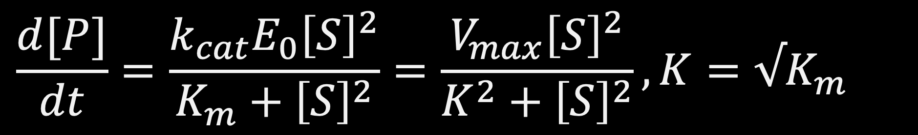
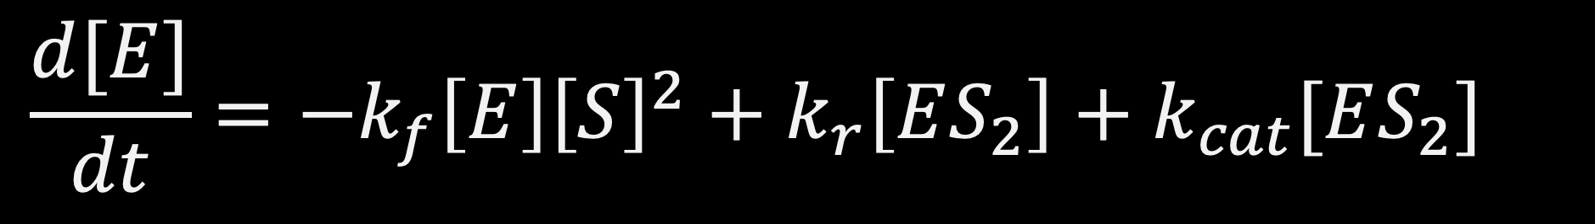
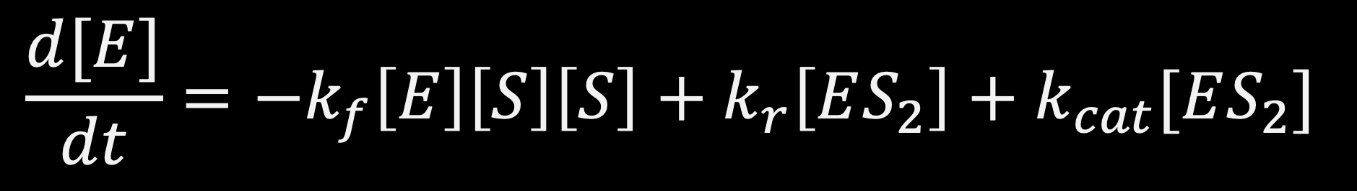
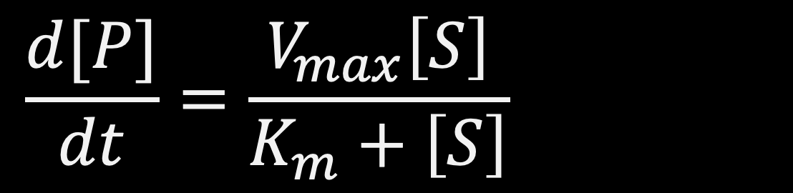
Michaelis-Menten Kinetics
Cooperative Enzymes (n=2)
Michaelian Enzymes
2
$$\frac{d[E]}{dt}=−k_{f}\left[E\right]\left[S\right]\left[S\right]+k_{r}\left[ES_{2}\right]+k_{cat}[ES_{2}]$$
$$\frac{d[P]}{dt}=\frac{V_{max}\left[S\right]}{K_{m}+\left[S\right]}$$
$$\frac{d[E]}{dt}=−k_{f}\left[E\right]{\left[S\right]}^{2}+k_{r}\left[ES_{2}\right]+k_{cat}[ES_{2}]$$
$$\frac{d[P]}{dt}=\frac{{k_{cat}E}_{0}{\left[S\right]}^{2}}{K_{m}+{\left[S\right]}^{2}}=\frac{V_{max}{\left[S\right]}^{2}}{K^{2}+{\left[S\right]}^{2}}, K=√K_{m}$$

Slide 11
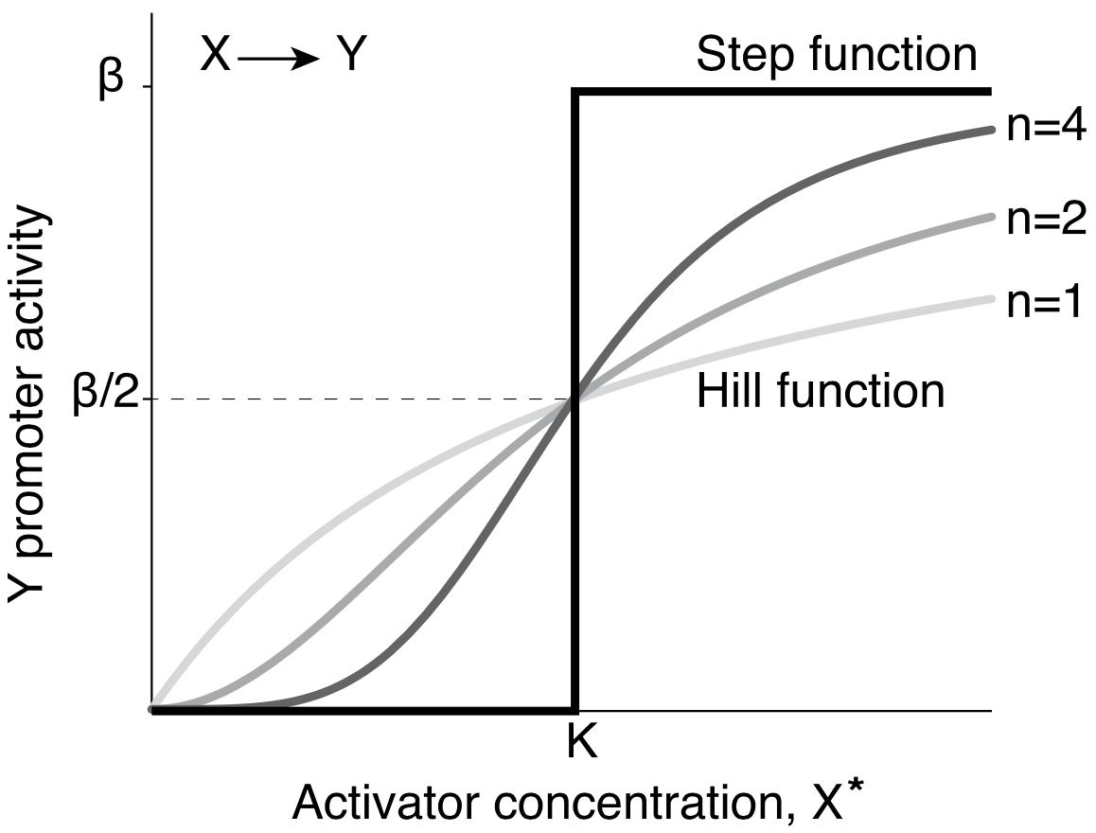
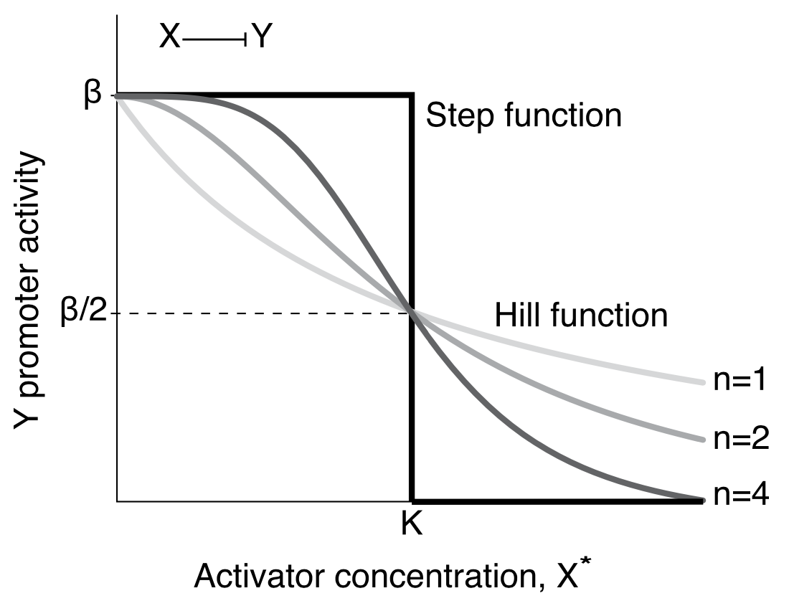
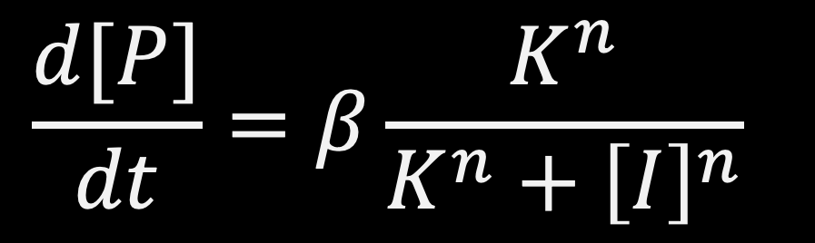
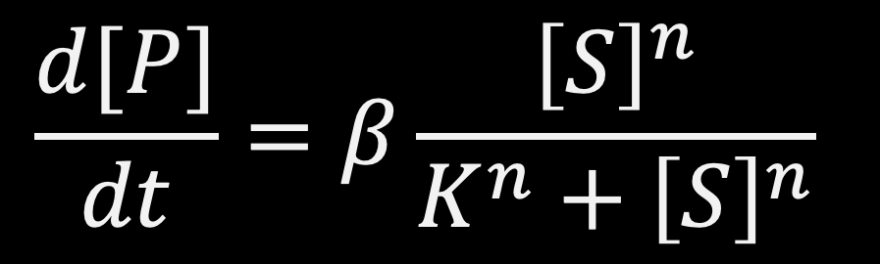
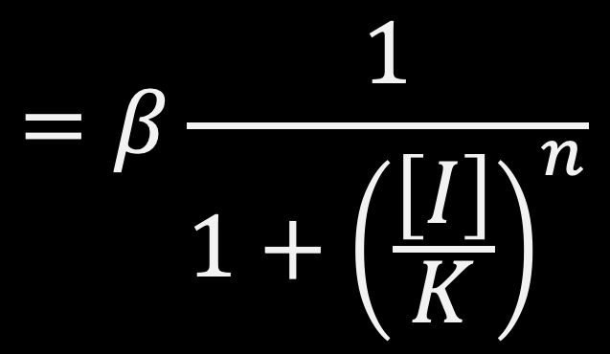
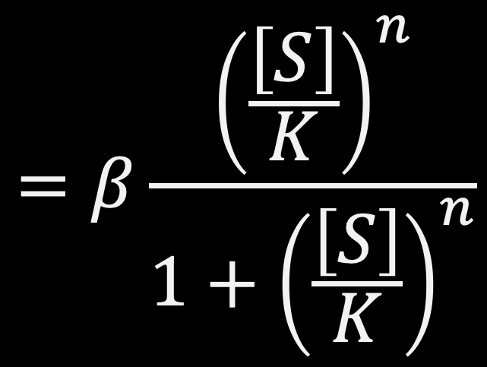

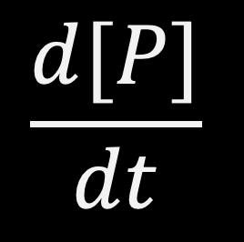
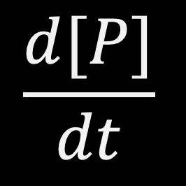

Hill functions
$$\frac{d[P]}{dt}$$
$$=β\frac{{\left(\frac{\left[S\right]}{K}\right)}^{n}}{1+{\left(\frac{\left[S\right]}{K}\right)}^{n}}$$
S activates p:
$$\frac{d[P]}{dt}=β\frac{{\left[S\right]}^{n}}{K^{n}+{\left[S\right]}^{n}}$$
K is called activation coefficient in units of concentration.
β is called maximal activity, and it is reached at high activator concentrations, [S] ≫ K.
Activator concentration, $[S]$
$$\frac{d[P]}{dt}$$
$$\frac{d[P]}{dt}=β\frac{K^{n}}{K^{n}+{\left[I\right]}^{n}}$$
$$=β\frac{1}{1+{\left(\frac{\left[I\right]}{K}\right)}^{n}}$$
I inhibits P:
Inhibitor concentration, $[I]$

Slide 12
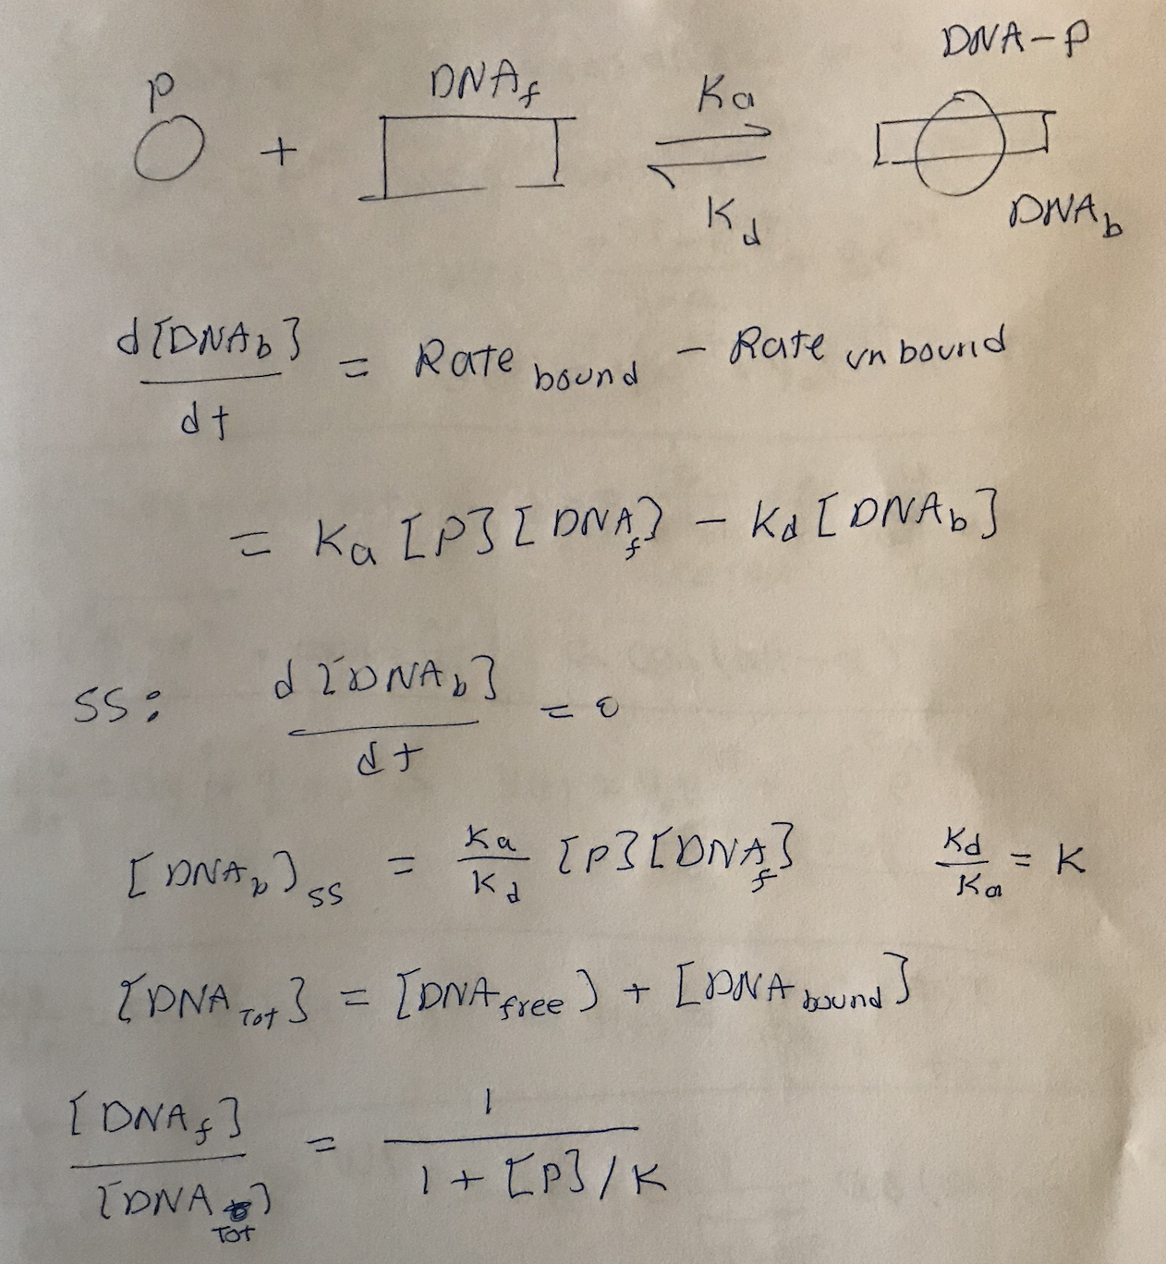
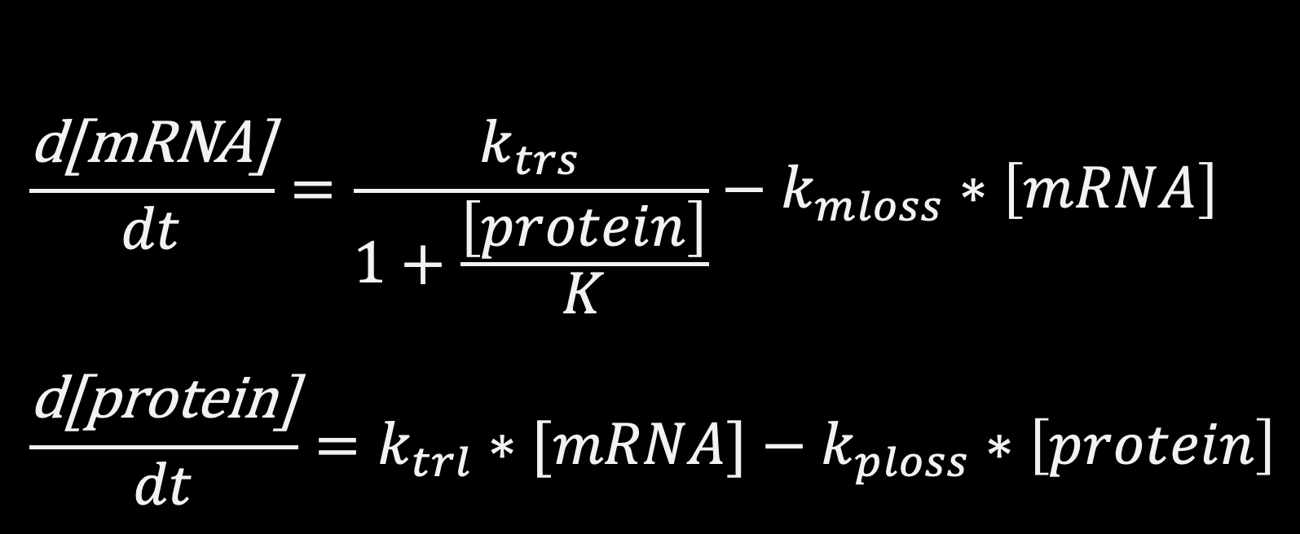
$$\frac{\text{d}\text{[}\text{mRNA}\text{]}}{dt}=\frac{k_{trs}}{1+\frac{\left[protein\right]}{K}}−k_{mloss}∗\left[mRNA\right]$$
$$\frac{\text{d}\text{[}\text{protein}\text{]}}{dt}=k_{trl}∗[mRNA]−k_{ploss}∗\left[protein\right]$$

Slide 13
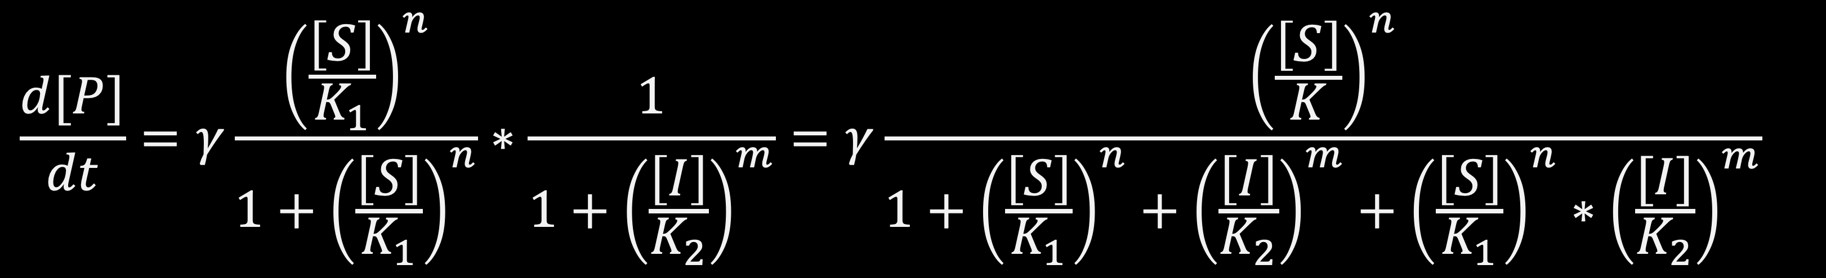
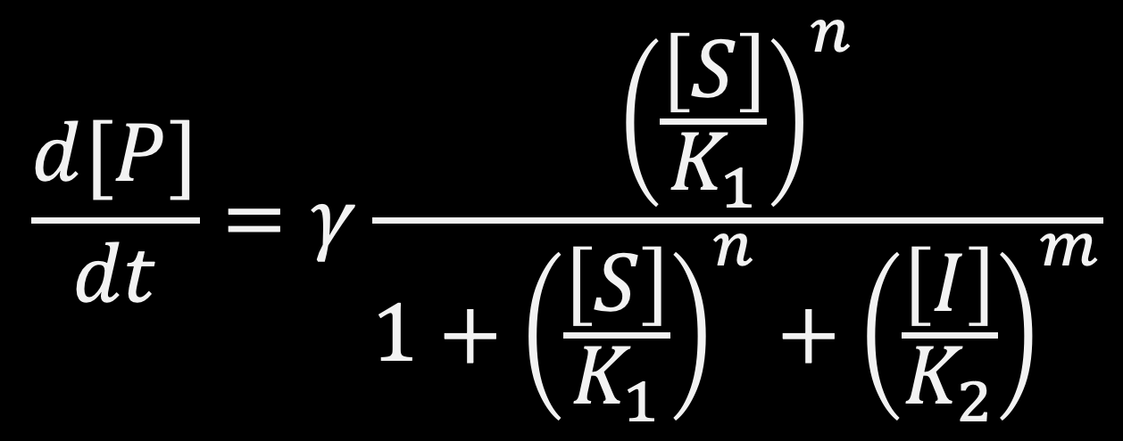
Multi input functions
Many proteins and genes are regulated by more than one regulator. The combined effect is described by multi-dimensional Hill functions.
Activator S
Inhibitor I
$$\frac{d[P]}{dt}=γ\frac{{\left(\frac{\left[S\right]}{K_{1}}\right)}^{n}}{1+{\left(\frac{\left[S\right]}{K_{1}}\right)}^{n}}∗\frac{1}{1+{\left(\frac{\left[I\right]}{K_{2}}\right)}^{m}}=γ\frac{{\left(\frac{\left[S\right]}{K}\right)}^{n}}{1+{\left(\frac{\left[S\right]}{K_{1}}\right)}^{n}+{\left(\frac{\left[I\right]}{K_{2}}\right)}^{m}+{\left(\frac{\left[S\right]}{K_{1}}\right)}^{n}{∗\left(\frac{[I]}{K_{2}}\right)}^{m}}$$
INDEPENDENT BINDING
AND-gate
$$\frac{d[P]}{dt}=γ\frac{{\left(\frac{\left[S\right]}{K_{1}}\right)}^{n}}{1+{\left(\frac{\left[S\right]}{K_{1}}\right)}^{n}+{\left(\frac{\left[I\right]}{K_{2}}\right)}^{m}}$$
COMPETITIVE BINDING
OR-gate

Slide 14
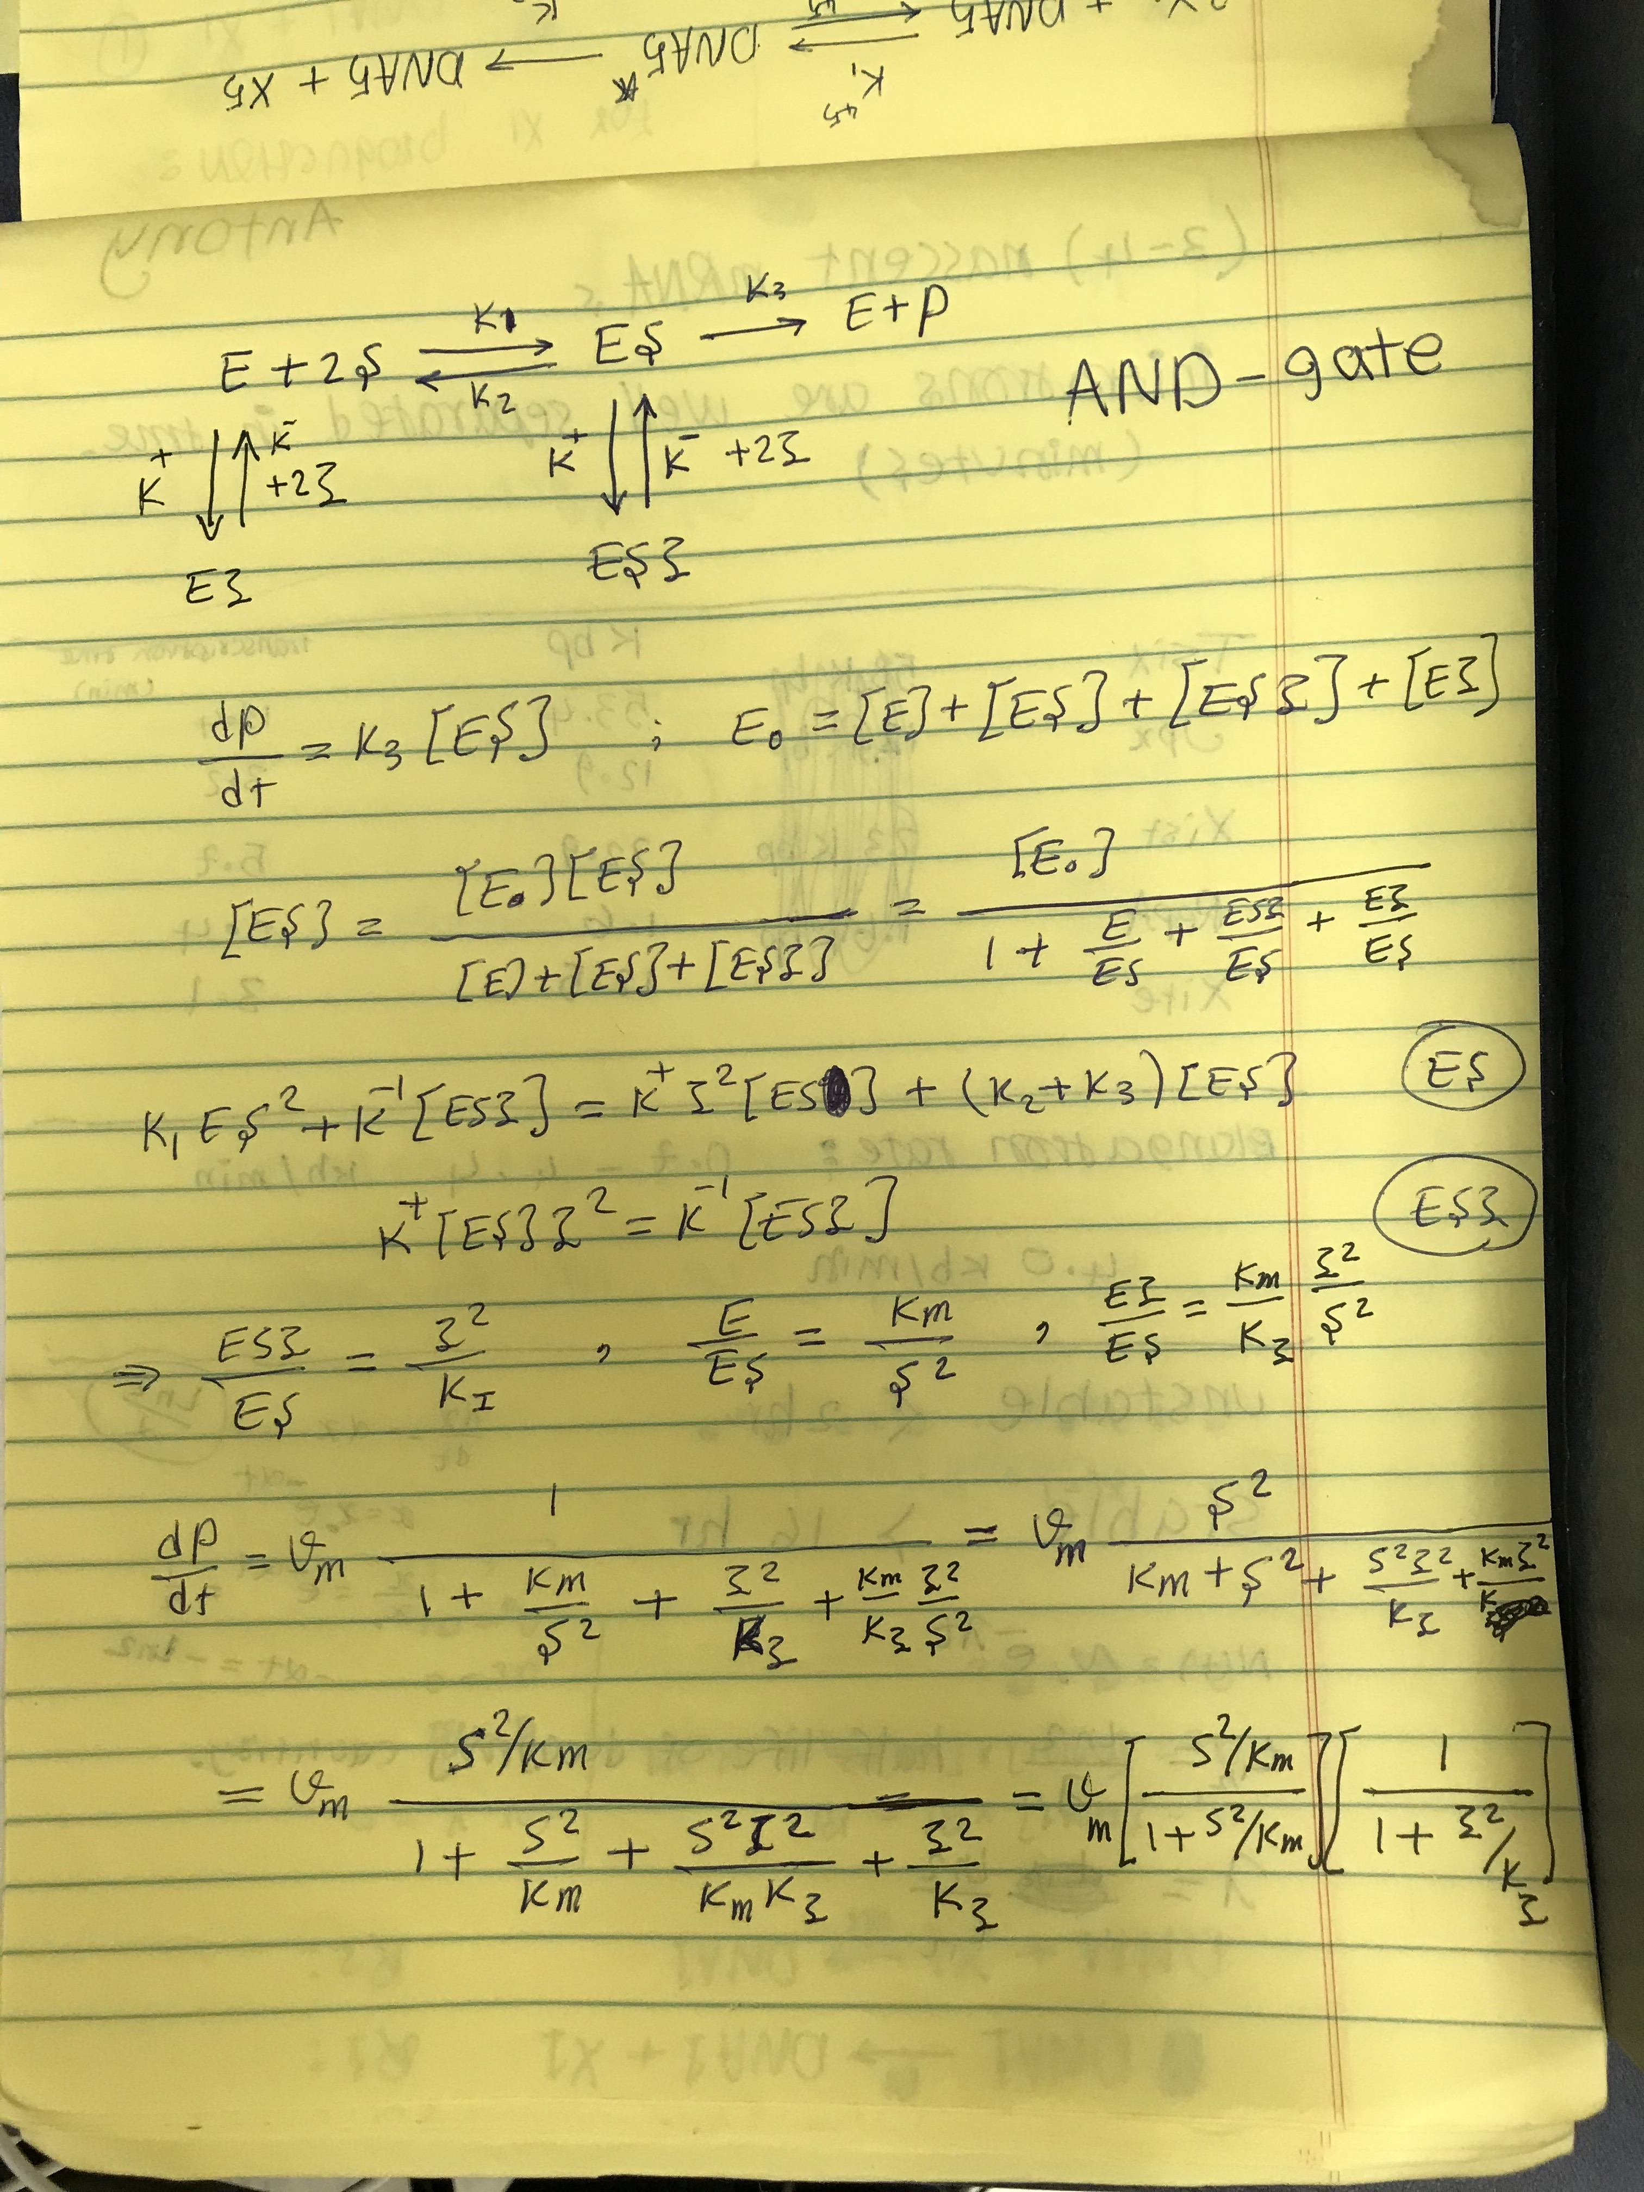
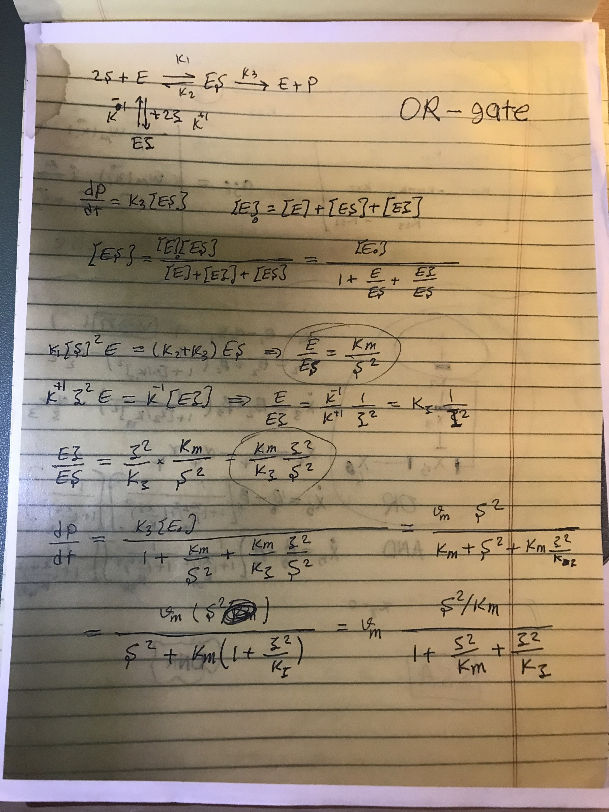
Multi input functions
Activator S
Inhibitor I
Many proteins and genes are regulated by more than one regulator. The combined effect is described by multi-dimensional Hill functions.
INDEPENDENT BINDING
AND-gate
COMPETITIVE BINDING
OR-gate

Slide 15
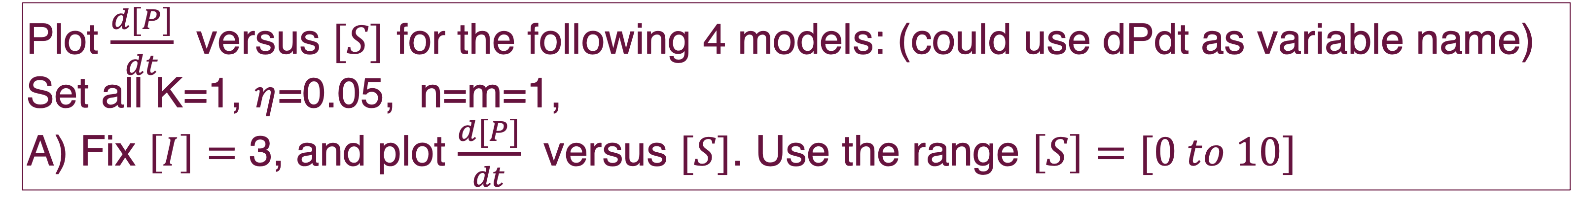



Project 5
Plot $\frac{d[P]}{dt}$ versus $[S]$ for the following 4 models: (could use dPdt as variable name)
Set all K=1, $η$=0.05, n=m=1,
A) Fix $\left[I\right]=$ 3, and plot $\frac{d[P]}{dt}$ versus $[S]$. Use the range $\left[S\right]=[0 to 10]$
Model 1: $\frac{d[P]}{dt}=\frac{{\left(\frac{\left[S\right]}{K_{1}}\right)}^{n}}{1+{\left(\frac{\left[S\right]}{K_{1}}\right)}^{n}}$ S activates P.
Model 2: $\frac{d[P]}{dt}=\frac{{\left(\frac{\left[S\right]}{K}\right)}^{n}}{1+{\left(\frac{\left[S\right]}{K_{1}}\right)}^{n}+{\left(\frac{\left[I\right]}{K_{2}}\right)}^{m}+{\left(\frac{\left[S\right]}{K_{1}}\right)}^{n}{∗\left(\frac{[I]}{K_{2}}\right)}^{m}}$ S activates P and I inhibits S.
Model 3: $\frac{d[P]}{dt}=\frac{{\left(\frac{\left[S\right]}{K}\right)}^{n}+η{\left(\frac{\left[S\right]}{K_{1}}\right)}^{n}{∗\left(\frac{[I]}{K_{2}}\right)}^{m}}{1+{\left(\frac{\left[S\right]}{K_{1}}\right)}^{n}+{\left(\frac{\left[I\right]}{K_{2}}\right)}^{m}+{\left(\frac{\left[S\right]}{K_{1}}\right)}^{n}{∗\left(\frac{[I]}{K_{2}}\right)}^{m}}$ S activates P and I inhibits S with basal.
Model 4: $\frac{d[P]}{dt}=\frac{{\left(\frac{\left[S\right]}{K}\right)}^{n}}{1+{\left(\frac{\left[S\right]}{K_{1}}\right)}^{n}+{\left(\frac{\left[I\right]}{K_{2}}\right)}^{m}}$ S activates P, I inhibits P, OR-gate.

Slide 16
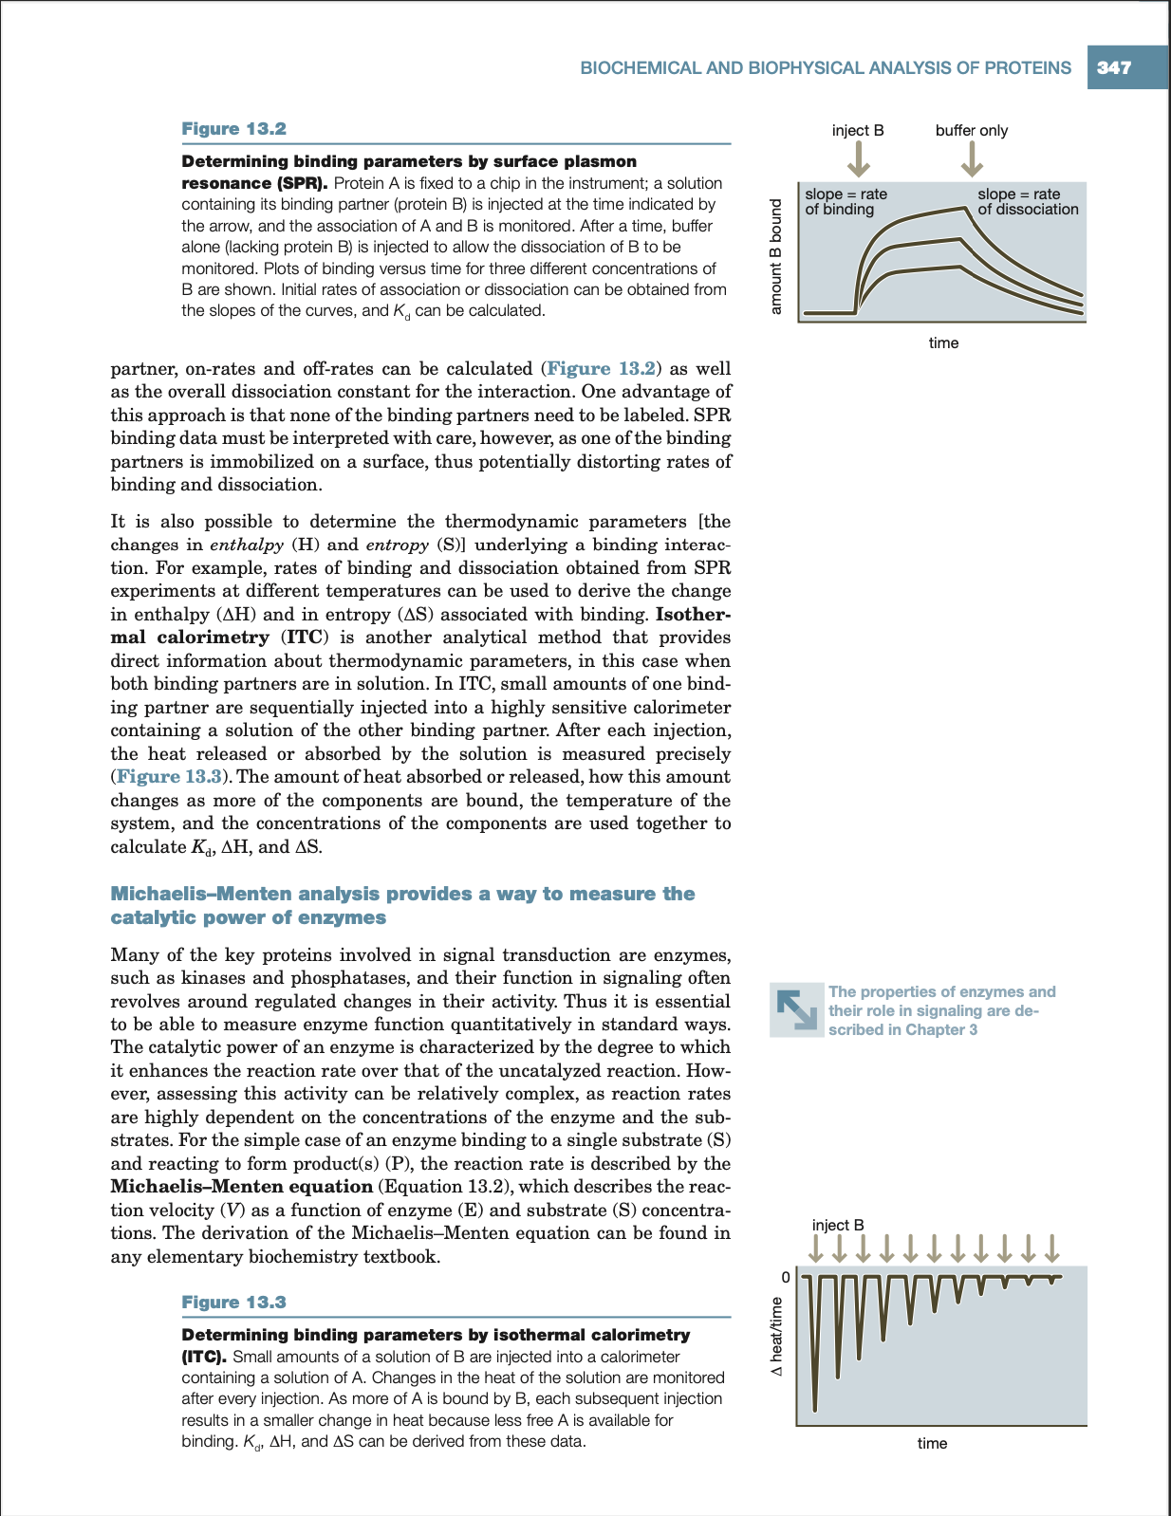
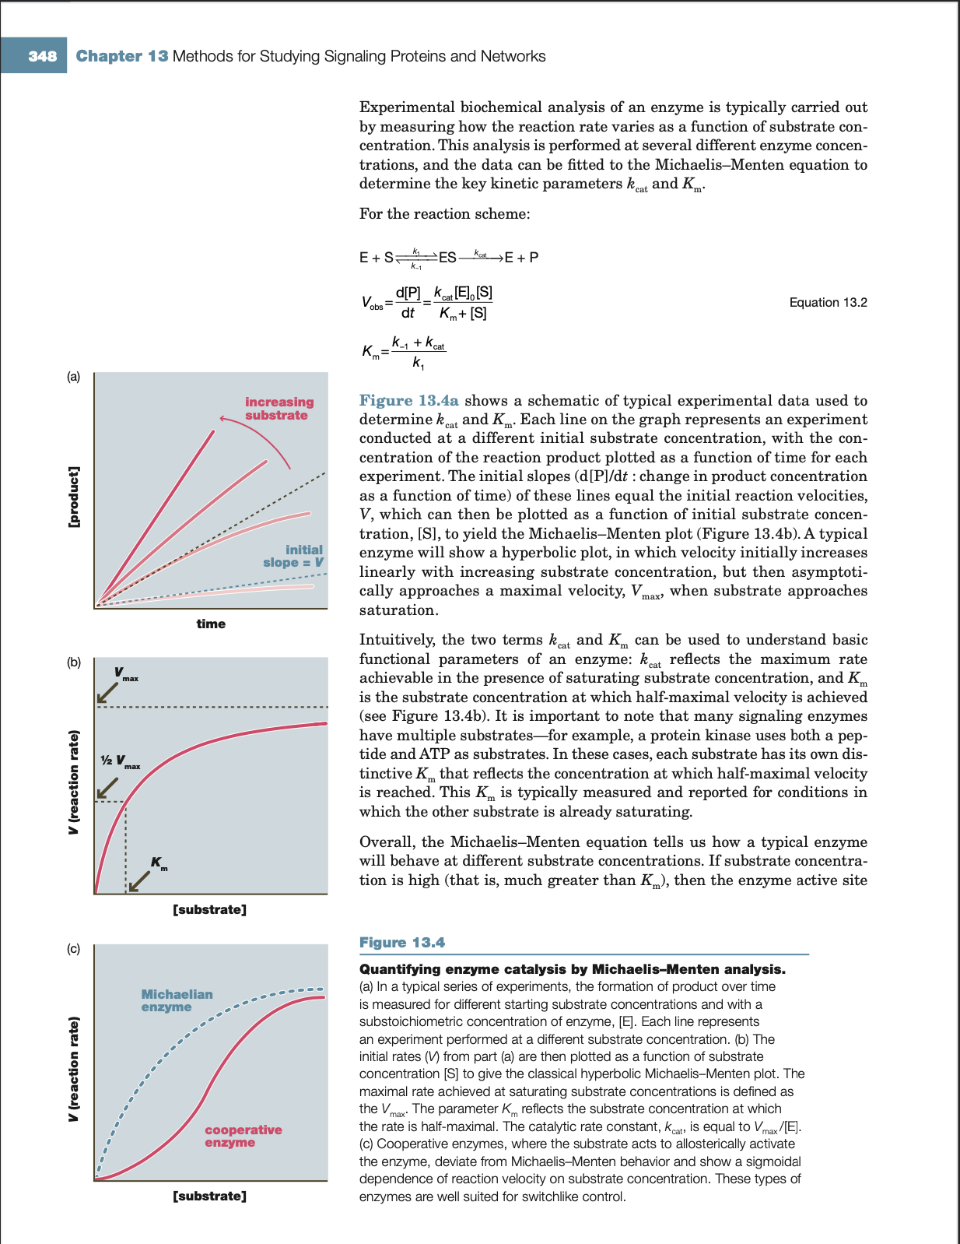
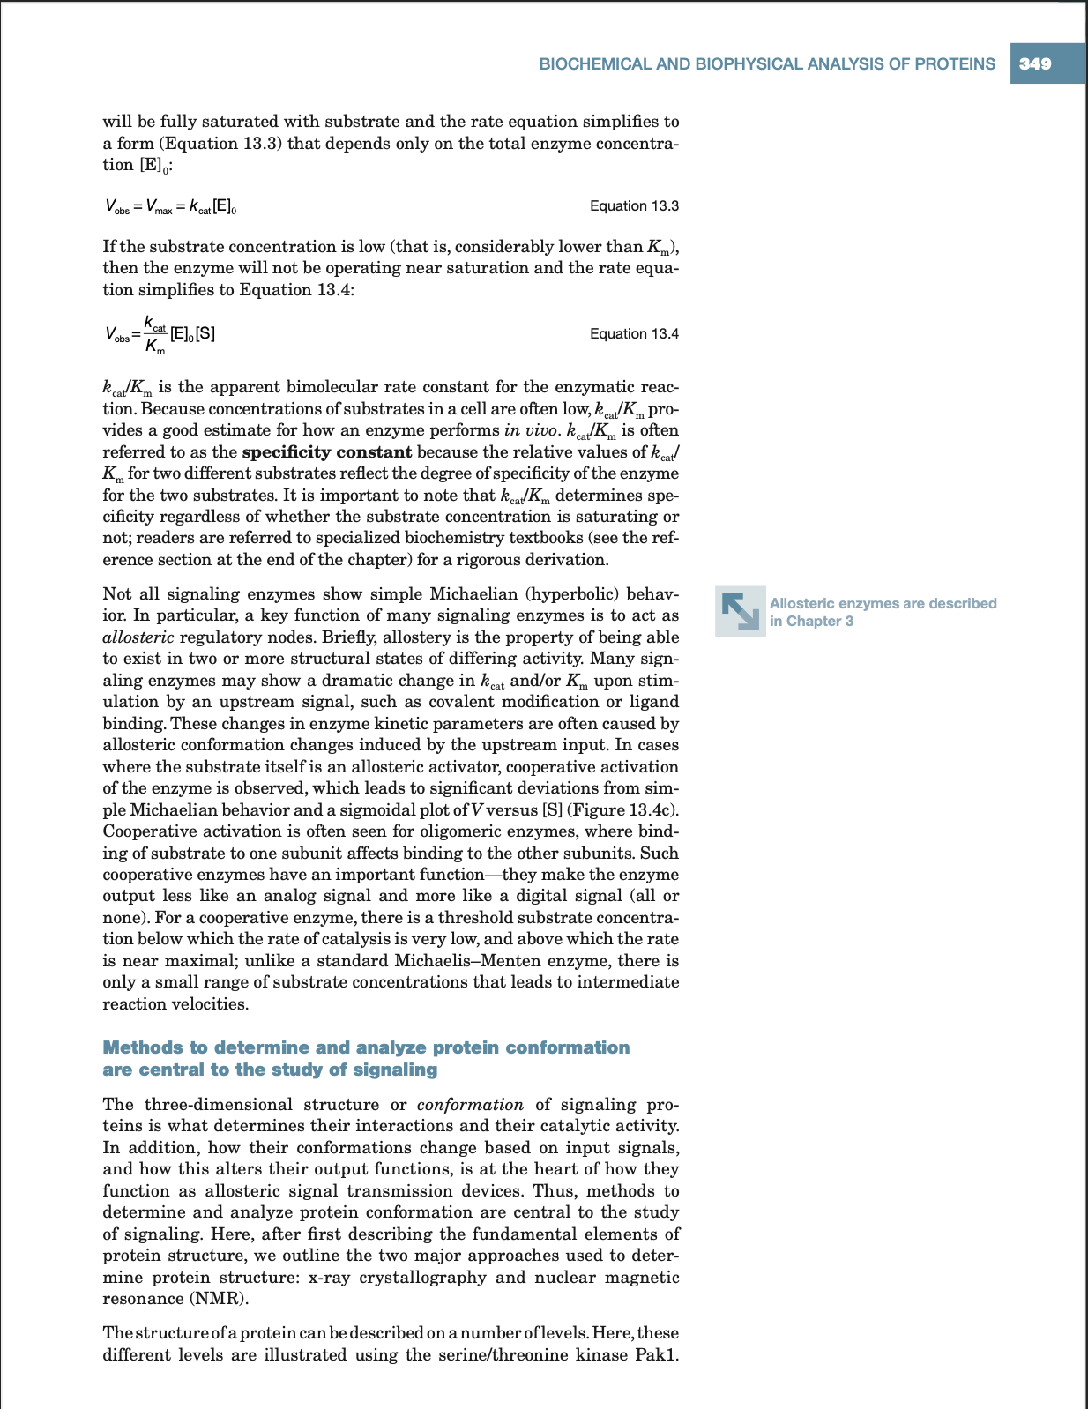

Slide 17
Introduction to ODEs
Graphical Analysis of ODEs
Michaelis-Menten and Mass Action Kinetics
Modeling biological systems with ODEs
We will build ODE models of regulatory networks of biological systems. Network nodes components change over time. Network, Matrix, ODEs representations.
Converting rules to ODEs
Modeling ODEs in Python
Solving ODEs
Projects

Slide 18
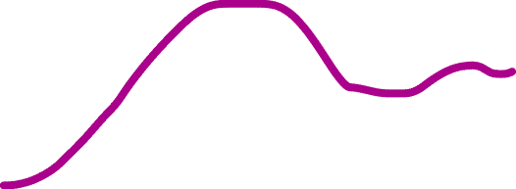
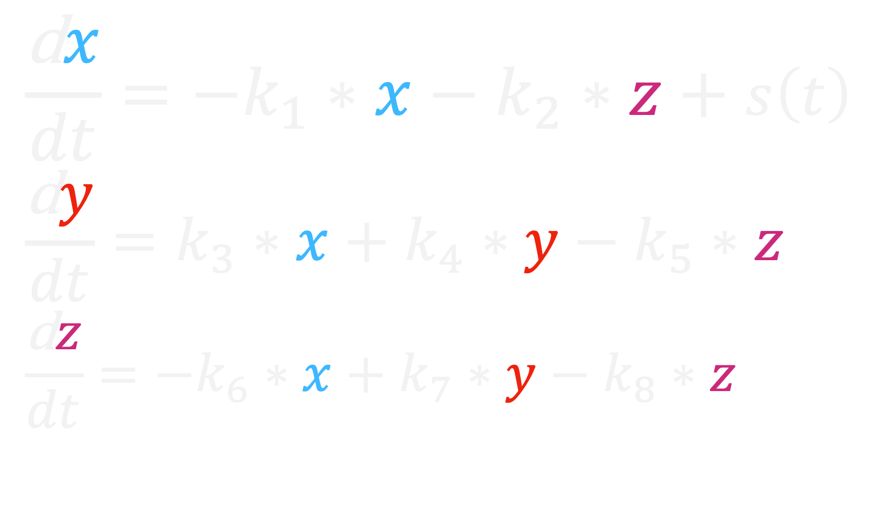
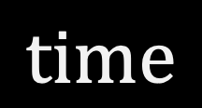

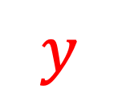

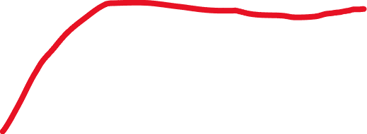
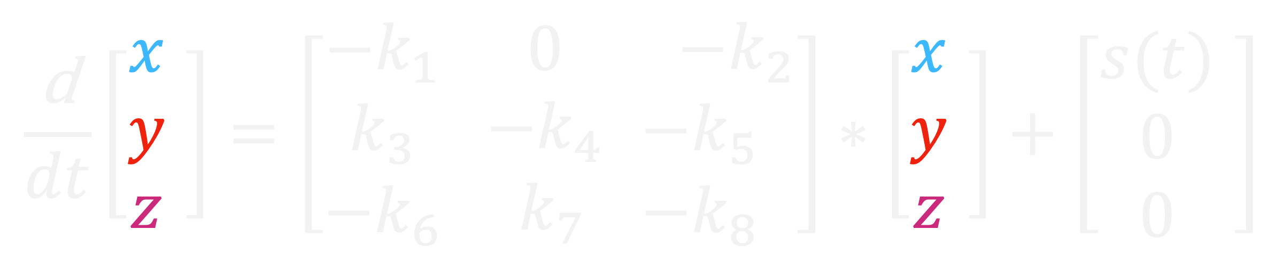
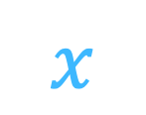



Converting rules to ODEs
$$\frac{\text{d}x}{dt}={−k}_{1}∗x−k_{2}∗z+s\left(t\right)$$
$$\frac{\text{d}y}{dt}=k_{3}∗x+k_{4}∗y−k_{5}∗z$$
$$\frac{\text{d}z}{dt}={−k}_{6}∗x+k_{7}∗y−k_{8}∗z$$
System of ODEs,$\{x(t), y(t), z\left(t\right)\}$
$$x$$
$$y$$
$$z$$
$$\frac{\text{d}}{dt}\left[\begin{matrix}x \\ y \\ z\end{matrix} \right]=\left[\begin{matrix}−k_{1} \\ k_{3} \\ −k_{6}\end{matrix} \begin{matrix} 0 \\ −k_{4} \\ { k}_{7}\end{matrix}\begin{matrix} −k_{2} \\ −k_{5} \\ −k_{8}\end{matrix}\right]∗\left[\begin{matrix}x \\ y \\ z\end{matrix} \right]+\left[\begin{matrix}s(t) \\ 0 \\ 0\end{matrix} \right]$$
$$s\left(t\right)$$
Solving ODEs to find phenotype description for the concentration of components through time.
Population dynamics
Bacteria communities
Signal transduction networks
Gene regulation networks
Cancer markers activities
Metabolic networks
x
y
$$Concentration$$
Z
$$time$$

Slide 19

Converting rules to ODEs
DOI: https://doi.org/10.1016/j.isci.2020.101565
Notes:
https://ars.els-cdn.com/content/image/1-s2.0-S2589004220307574-mmc1.pdf

Slide 20

Converting rules to ODEs
DOI: https://doi.org/10.1016/j.cell.2009.06.013

Slide 21


Adaptation as a biological function
To read to next Tuesday
Introduction,
methods,
Results
Searching for Circuits Capable of Adaptation
Identifying Minimal Adaptation Networks
DOI: https://doi.org/10.1016/j.cell.2009.06.013

Slide 22






Modeling ODEs in Python

Slide 23
Project 6
Choose a circuit from the Ma 2009 paper, Figure 2
Group A: choose a model from Negative Feedback Loops
Group B: choose a model from Incoherent Feedforward Loops
Select a model that has maximum probability capable of adaptation.
Draw network representation. Include basal deactivations on all three nodes.
Write down the Input, Internode Interaction, and Basal Matrixes.
Set the input to a step change function from 1 to 1.5 which activates node A.
Build your models in Python using both mass-action and Michaelis-Menten regulations (models will have different number of parameters). For each of these 2 models, perform the following analysis:
Solve and plot the model for a defined parameter set.
Sample 10,000 parameter sets from a uniform distribution at range: [LB,UB] = [-2,+2]
Solve the model for all the parameter sets (10^[params]) and save the solutions in a numpy.array
Discard solutions and parameter sets if any nodes activity go beyond [0,1]
Define adaptation as a python function
def adaptation(O=C):
SENS = max(O)
PREC = 1/O(end)
Adaptive =
if O(end) < max(O)
1
else
0
return [SENS, PREC, Adaptive]
# C is the concentration/activity of node C over time for any given parameter set.

Slide 24
Project 6
Plot log10(PREC) versus log10(SENS) for all parameter sets.
Save solutions and parameter sets if adaptation is achieved in new arrays.
Plot solutions for all adaptive parameter sets using the slider widget.
Plot scatters of adaptive parameter sets (for pairs of model parameters)
for i =1:n_params
for j =1:n_params
subplot(n_params, n_params, count)
if j>i
scaterplot(P(:,i), P(:,j))
end
end
count = count + 1
set xlim and ylim to [LB,UB]
end
# P include all the parameter sets that achieved adaptation. Each row includes one set.

